Slide 1
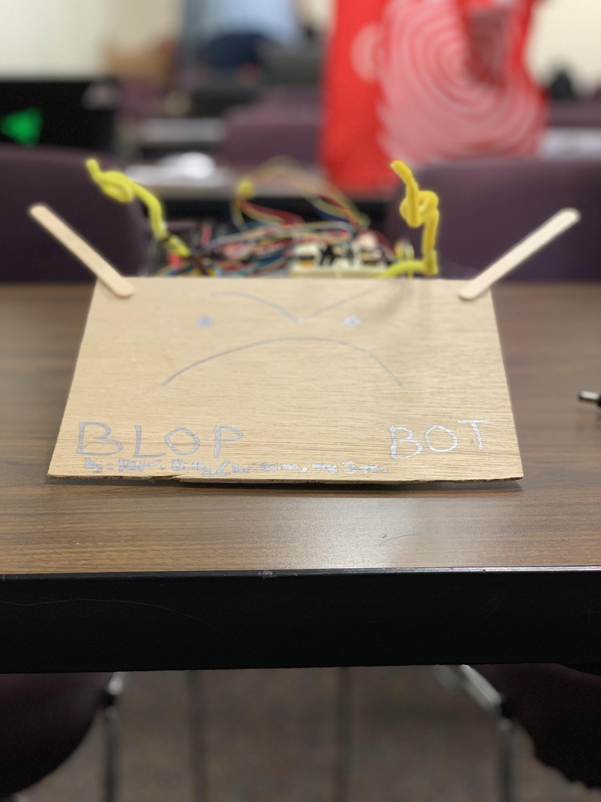

Blop “Tha Bully” Bot
By: Peter, Billy, Christian, and Jake

Slide 2
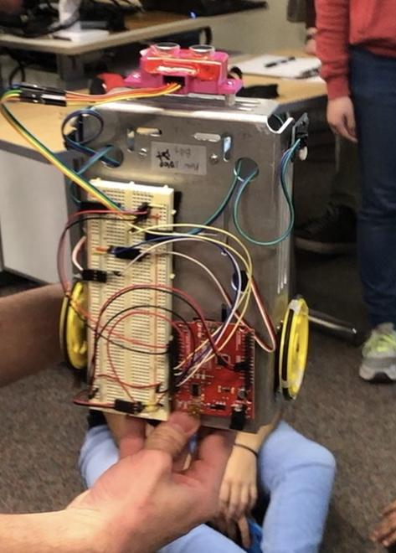
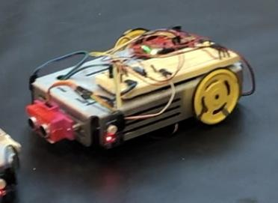
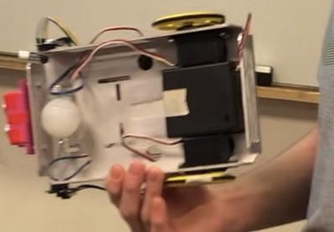
Sumo Competition One
Notes:
-In the first competition there was not a lot we could add to give us a sure advantage other than the code and the sturdiness of our build. -Our focus was centralized more on Blop’s defensive capabilities and making sure it stayed in the circle. Biggest vulnerability was from the side and our code ensured we would back up if it hits the edge and turn a certain way to escape as demonstrated in this next video.

Slide 3

Blop Bot Model One in action
Notes:
Start at 19 seconds hooked at 30 attack and finish at 49
Most of our sumo matches were won simply because Blop Bot was stronger than our competition. He would stay in the circle when attacked and mostly win in head to head matchups. We knew this would not be as simple the second time around so we came up with a strategy to try and counter this.

Slide 4
Programming and exterior design purposes
-Move forward at the start → charge the other robot & push it out with the help of the ramp.
-Added weight in the back to counteract weight from picking up a robot.
-Intended to add other features such as a motor driver with two wheels in the back for added strength but due to length restrictions and other difficulties it did not make the final cut.
-Reverse and turn when near edge, turn towards opponent when detected by sensor.
Notes:
Goal would be too lift opposing robot and prevent their wheels from gaining any traction.
-Originally our wheels would get picked up from the back and they would no longer touch the ground making us easy targets.,

Slide 5
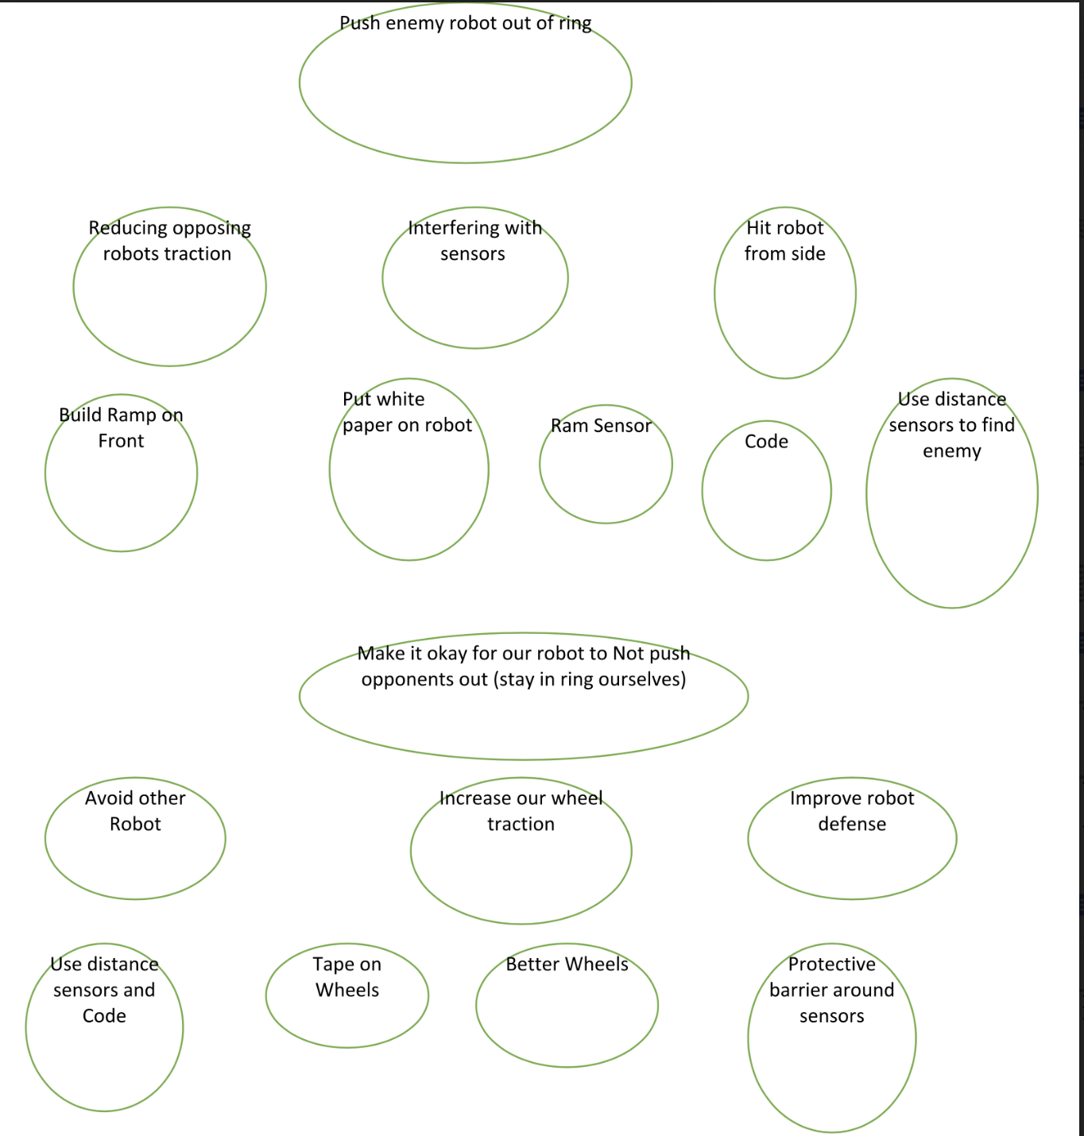
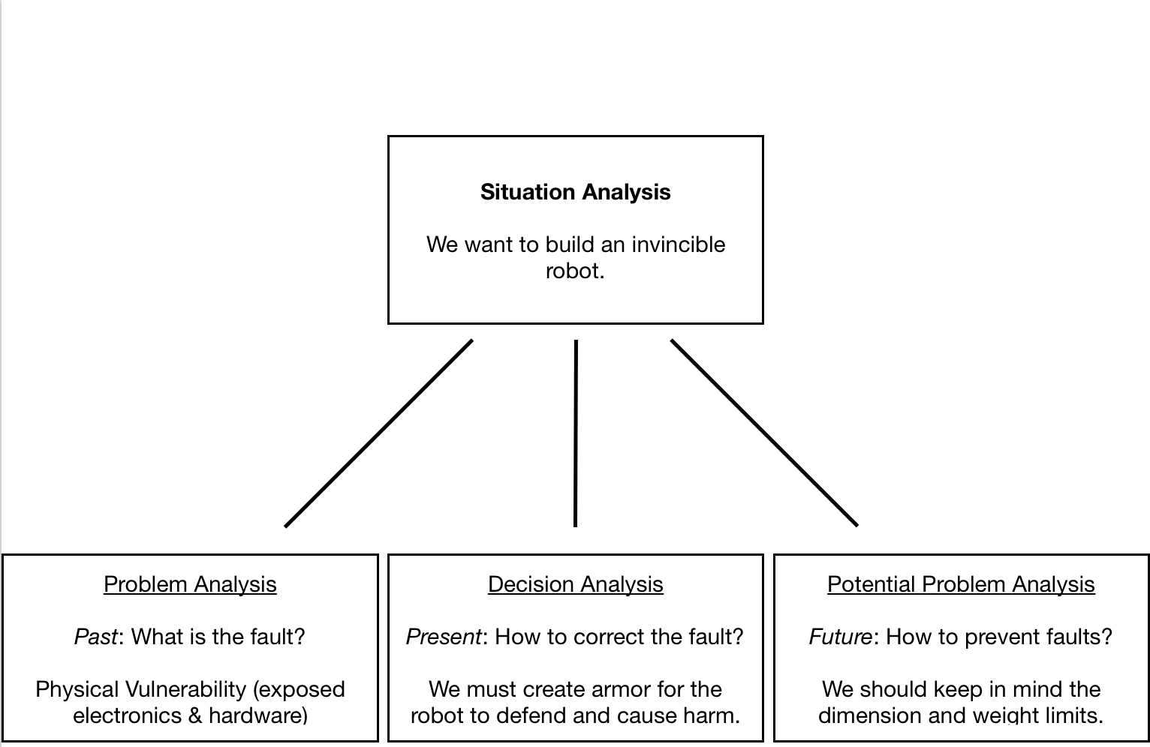
Brainstorming
J
KT Situation Analysis
Duncker Diagram

Slide 6
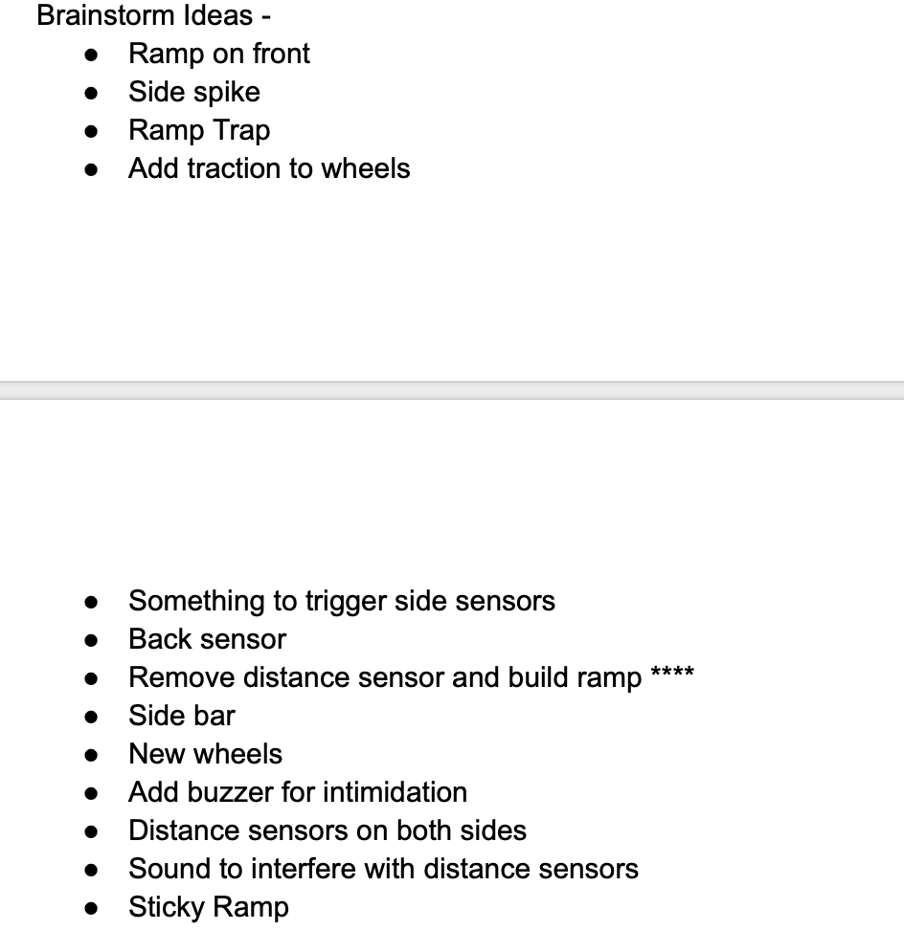
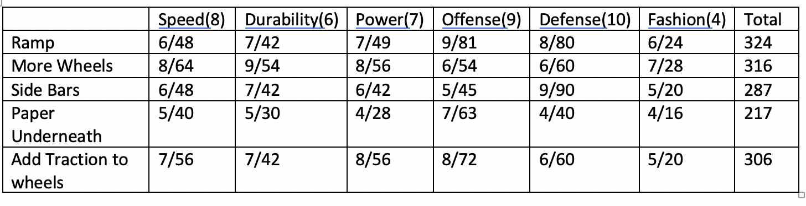
Alternate Designs
We utilized a Decision Matrix to decide what solutions to attempt to implement.

Slide 7
Prototypes
We attempted to prototype the designs that scored the highest points in our decision matrix
While our #1 implementation succeeded, our #2 failed and we were forced to go with our #3 implementation instead

Slide 8
Design of Exterior
Pre-Competition Additions:
Ramp
Tape on Wheels
Mid-Competition Adjustments
Rear-tape
Ramp-tape & popsicle sticks

Slide 9
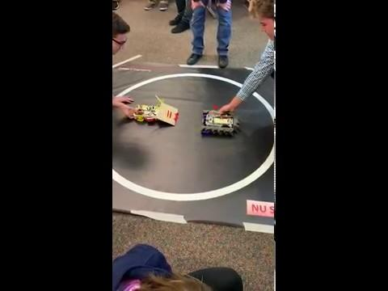
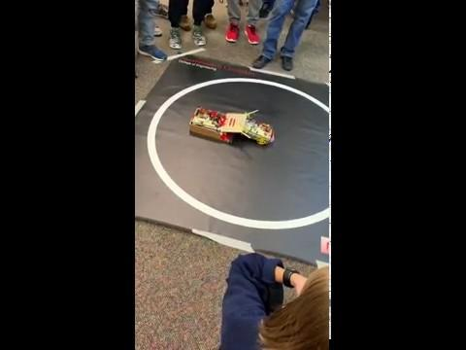
Robot in Action

Slide 10
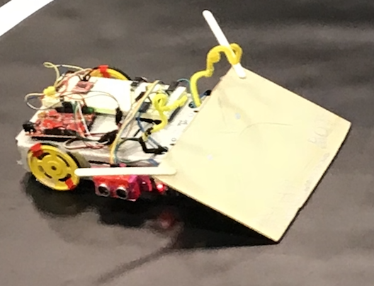
What Worked?
Our code
Side sensors
Not too complicated
The ramp
Offense and defense, pushing other robots out of ring

Slide 11
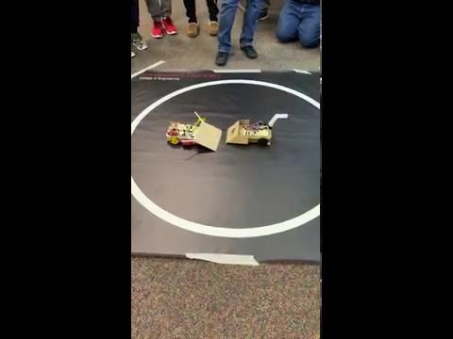
What Did Not Work?
Ramp didn’t work against other robots with ramps
Due to little space between ground and ramp

Slide 12
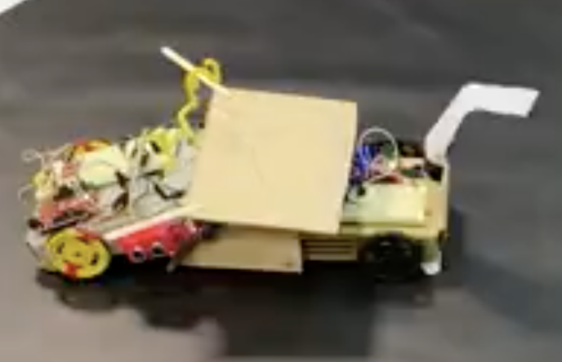
What Would We Do Differently?
Improve distance sensor
Either put on other side of robot or put two distance sensors on
Improve the ramp
Trimmed bottom of the ramp
Keep in contact with the ground
Sand the bottom

Slide 13
Thanks for Watching! - by Blop Bot

